Slide 1

Syllabus
UNIT – V (12 Hours) -
Issues in cloud computing, Implementing real time application over cloud platform Issues in Intercloud environments, QOS Issues in Cloud, Dependability, datamigration, streaming in Cloud. Quality of Service (QoS) monitoring in a Cloud computing environment. Cloud Middleware. Mobile Cloud Computing. Inter Cloud issues. A grid of clouds, Sky computing, load balancing, resource optimization, resource dynamic reconfiguration, Monitoring in Cloud

Slide 2
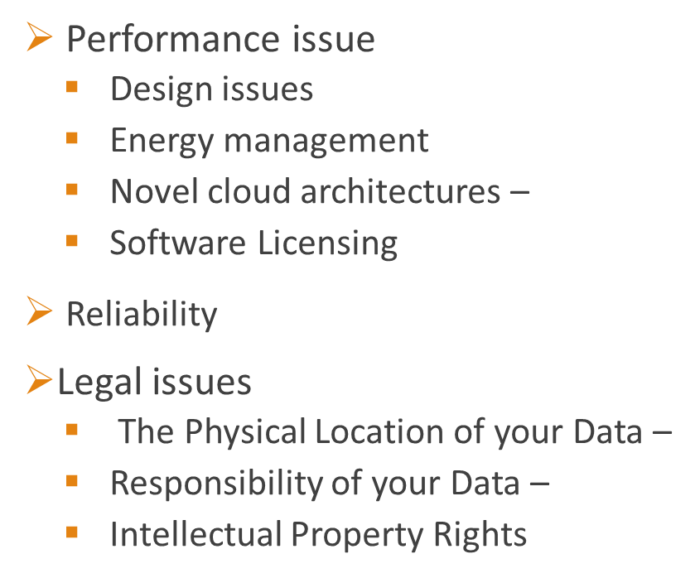
ISSUES IN CLOUD COMPUTING
Security issues
Physical security
Operational security
Programmatic security
Data issues
Data backup
Data usage
Data loss
Data integrity
Data theft

Slide 3
Some of the security problem which is faced by the Cloud computing,
Data Integrity
When a data is on a cloud anyone from any location can access those data’s from the cloud. Cloud does not differentiate between a sensitive data from a common data thus enabling anyone to access those sensitive data’s. Thus there is a lack of data integrity in cloud computing
Data Theft
Most of the cloud Vendors instead of acquiring a server tries to lease a server from other service providers because they are cost affective and flexible for operation. The customer doesn’t know about those things, there is a high possibility that the data can be stolen from the external server by a malicious user.

Slide 4
Security on Vendor level
Vendor should make sure that the server is well secured from all the external threats it may come across. A Cloud is good only when there is a good security provided by the vendor to the customers.
Security on User level
Even though the vendor has provided a good security layer for the customer, the customer should make sure that because of its own action, there shouldn’t be any loss of data or tampering of data for other users who are using the same Cloud.
Information Security
Security related to the information exchanged between different hosts or between hosts and users. This issues pertaining to secure communication, authentication, and issues concerning single sign on and delegation.

Slide 5
DATA ISSUES
Data Loss :-
Data loss is a very serious problem in Cloud computing. If the vendor closes due to financial or legal problems there will be a loss of data for the customers. The customers won’t be able to access those data’s because data is no more available for the customer as the vendor shut down.
Data Location :-
When it comes to location of the data nothing is transparent even the customer don’t know where his own data’s are located. The Vendor does not reveal where all the data’s are stored. The Data’s won’t even be in the same country of the Customer, it might be located anywhere in the world.
Data Lock-In :-
Software stacks have improved interoperability among platforms, but the APIs for Cloud Computing itself are still essentially proprietary, or at least have not been the subject of active standardization. Thus, customers cannot easily extract their data and programs from one site to run on another

Slide 6
Data segregation :-
Data in the cloud is typically stored in a shared environment whereby one customer’s data is stored alongside another customer’s data. hence it is difficult to assure data segregation. customers should review the cloud vendor’s architecture to ensure proper data segregation is available and that data leak prevention (DLP) measures are in place.
Data Confidentiality and Auditability :-
Current cloud offerings are essentially public (rather than private) networks, exposing the system to more attacks. Auditability could be added as an additional layer beyond the reach of the virtualized guest OS (or virtualized application environment), providing facilities arguably more secure than those built into the applications themselves and centralizing the software responsibilities related to confidentiality and auditability into a single logical layer
Deletion of data :-
An essential point is that data that has to be deleted by the user because he or she no longer needs it or may no longer process it for another reason is also deleted by the provider and no more copies of data are available. This can lead to problems, in particular in connection with backups that are created by the provider if these contain data belonging to a number of his customers and targeted deletion of individual data items proves financially unreasonable or technically inappropriate in terms of feasibility

Slide 7
Restitution of data :-
Upon termination of the contract, the orderly return of data to the user has to be ensured. This requires sufficiently long periods of notice for the user to be able to take the necessary measures to ensure the availability and constant further processing of data after termination of the contract. The form in which the data is to be delivered to the user by the provider must also be ascertained.
Service level agreements :-
According to the purpose for which the data is processed it is important to agree on binding service levels for availability and data recovery and if necessary, safeguarded by supporting fixed penalties in the event of non-compliance with the agreed service levels.

Slide 8
PERFOMANCE ISSUES
WHY PERFOMANCE ?
Poor application performance causes companies to lose customers, reduce employee productivity, and reduce bottom line revenue.
• Positive employee productivity relies on solid and reliable application performance to complete work accurately and quickly
In general the issues may be…
• Poor application performance or application hang-ups : Usually the application is starved for RAM or CPU cycles, and faster processors or more RAM is added.
• Slow access to applications and data : Bandwidth is usually the cause, and the most common solution is to add faster network connections.
• Hence, Adding virtual machines may be a short-term solution to the problem

Slide 9
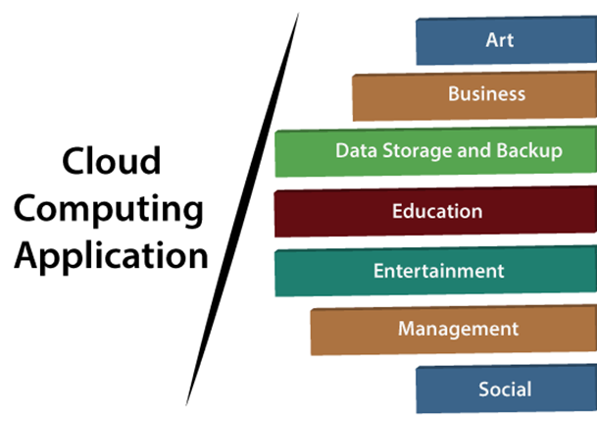
Implementing real time application over cloud platform
Cloud service providers provide various applications in the field of art, business, data storage and backup services, education, entertainment, management, social networking, etc.

Slide 10
Art Applications
Cloud computing offers various art applications for quickly and easily design attractive cards, booklets, and images. Some most commonly used cloud art applications are given below:
i Moo
Moo is one of the best cloud art applications. It is used for designing and printing business cards, postcards, and mini cards.
ii. Vistaprint
Vistaprint allows us to easily design various printed marketing products such as business cards, Postcards, Booklets, and wedding invitations cards.
iii. Adobe Creative Cloud
Adobe creative cloud is made for designers, artists, filmmakers, and other creative professionals. It is a suite of apps which includes PhotoShop image editing

Slide 11
Business Applications
Business applications are based on cloud service providers. Today, every organization requires the cloud business application to grow their business. It also ensures that business applications are 24*7 available to users.
There are the following business applications of cloud computing -
i. MailChimp
MailChimp is an email publishing platform which provides various options to design, send, and save templates for emails.
iii. Salesforce
Salesforce platform provides tools for sales, service, marketing, e-commerce, and more. It also provides a cloud development platform.
iv. Chatter
Chatter helps us to share important information about the organization in real time.

Slide 12
Business Applications
v. Bitrix24
Bitrix24 is a collaboration platform which provides communication, management, and social collaboration tools.
vi. Paypal
Paypal offers the simplest and easiest online payment mode using a secure internet account. Paypal accepts the payment through debit cards, credit cards, and also from Paypal account holders.
vii. Slack
Slack stands for Searchable Log of all Conversation and Knowledge. It provides a user-friendly interface that helps us to create public and private channels for communication.
viii. Quickbooks
Quickbooks works on the terminology "Run Enterprise anytime, anywhere, on any device." It provides online accounting solutions for the business. It allows more than 20 users to work simultaneously on the same system.

Slide 13
Data Storage and Backup Applications
Cloud computing allows us to store information (data, files, images, audios, and videos) on the cloud and access this information using an internet connection. As the cloud provider is responsible for providing security, so they offer various backup recovery application for retrieving the lost data.
A list of data storage and backup applications in the cloud are given below -
i. Box.com
Box provides an online environment for secure content management, workflow, and collaboration. It allows us to store different files such as Excel, Word, PDF, and images on the cloud. The main advantage of using box is that it provides drag & drop service for files and easily integrates with Office 365, G Suite, Salesforce, and more than 1400 tools.

Slide 14
Data Storage and Backup Applications
ii. Mozy
Mozy provides powerful online backup solutions for our personal and business data. It schedules automatically back up for each day at a specific time.
iii. Joukuu
Joukuu provides the simplest way to share and track cloud-based backup files. Many users use joukuu to search files, folders, and collaborate on documents.
iv. Google G Suite
Google G Suite is one of the best cloud storage and backup application. It includes Google Calendar, Docs, Forms, Google+, Hangouts, as well as cloud storage and tools for managing cloud apps. The most popular app in the Google G Suite is Gmail. Gmail offers free email services to users.

Slide 15
Education Applications
Cloud computing in the education sector becomes very popular. It offers various online distance learning platforms and student information portals to the students. The advantage of using cloud in the field of education is that it offers strong virtual classroom environments, Ease of accessibility, secure data storage, scalability, greater reach for the students, and minimal hardware requirements for the applications.
There are the following education applications offered by the cloud as:
i. Google Apps for Education
Google Apps for Education is the most widely used platform for free web-based email, calendar, documents, and collaborative study.

Slide 16
Education Applications
ii. Chromebooks for Education
Chromebook for Education is one of the most important Google's projects. It is designed for the purpose that it enhances education innovation.
iii. Tablets with Google Play for Education
It allows educators to quickly implement the latest technology solutions into the classroom and make it available to their students.
iv. AWS in Education
AWS cloud provides an education-friendly environment to universities, community colleges, and schools.

Slide 17
Entertainment Applications
Entertainment industries use a multi-cloud strategy to interact with the target audience. Cloud computing offers various entertainment applications such as online games and video conferencing.
i. Online games
Today, cloud gaming becomes one of the most important entertainment media. It offers various online games that run remotely from the cloud. The best cloud gaming services are Shaow, GeForce Now, Vortex, Project xCloud, and PlayStation Now.
ii. Video Conferencing Apps
Video conferencing apps provides a simple and instant connected experience. It allows us to communicate with our business partners, friends, and relatives using a cloud-based video conferencing. The benefits of using video conferencing are that it reduces cost, increases efficiency, and removes interoperability.

Slide 18
Management Applications
Cloud computing offers various cloud management tools which help admins to manage all types of cloud activities, such as resource deployment, data integration, and disaster recovery. These management tools also provide administrative control over the platforms, applications, and infrastructure.
Some important management applications are -
i. Toggl
Toggl helps users to track allocated time period for a particular project.
ii. Evernote
Evernote allows you to sync and save your recorded notes, typed notes, and other notes in one convenient place. It is available for both free as well as a paid version. It uses platforms like Windows, macOS, Android, iOS, Browser, and Unix.
iii. Outright
Outright is used by management users for the purpose of accounts. It helps to track income, expenses, profits, and losses in real-time environment.
iv. GoToMeeting
GoToMeeting provides Video Conferencing and online meeting apps, which allows you to start a meeting with your business partners from anytime, anywhere using mobile phones or tablets. Using GoToMeeting app, you can perform the tasks related to the management such as join meetings in seconds, view presentations on the shared screen, get alerts for upcoming meetings, etc.

Slide 19
Social Applications
Social cloud applications allow a large number of users to connect with each other using social networking applications such as Facebook, Twitter, Linkedln, etc.
There are the following cloud based social applications -
i. Facebook
Facebook is a social networking website which allows active users to share files, photos, videos, status, more to their friends, relatives, and business partners using the cloud storage system. On Facebook, we will always get notifications when our friends like and comment on the posts.
ii. Twitter
Twitter is a social networking site. It is a microblogging system. It allows users to follow high profile celebrities, friends, relatives, and receive news. It sends and receives short posts called tweets.
iii. Yammer
Yammer is the best team collaboration tool that allows a team of employees to chat, share images, documents, and videos.
iv. LinkedIn
LinkedIn is a social network for students, freshers, and professionals.

Slide 20
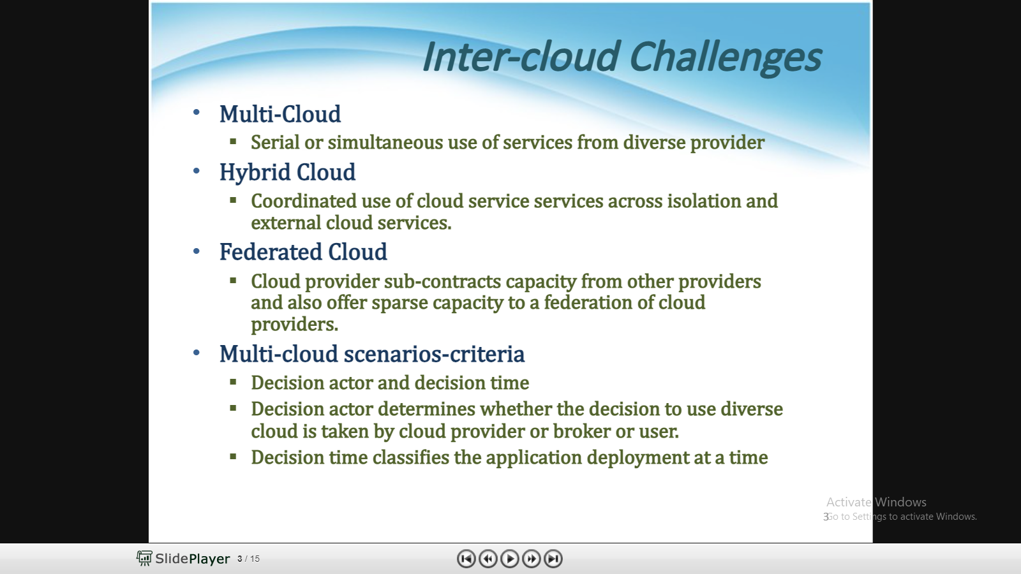

Slide 21
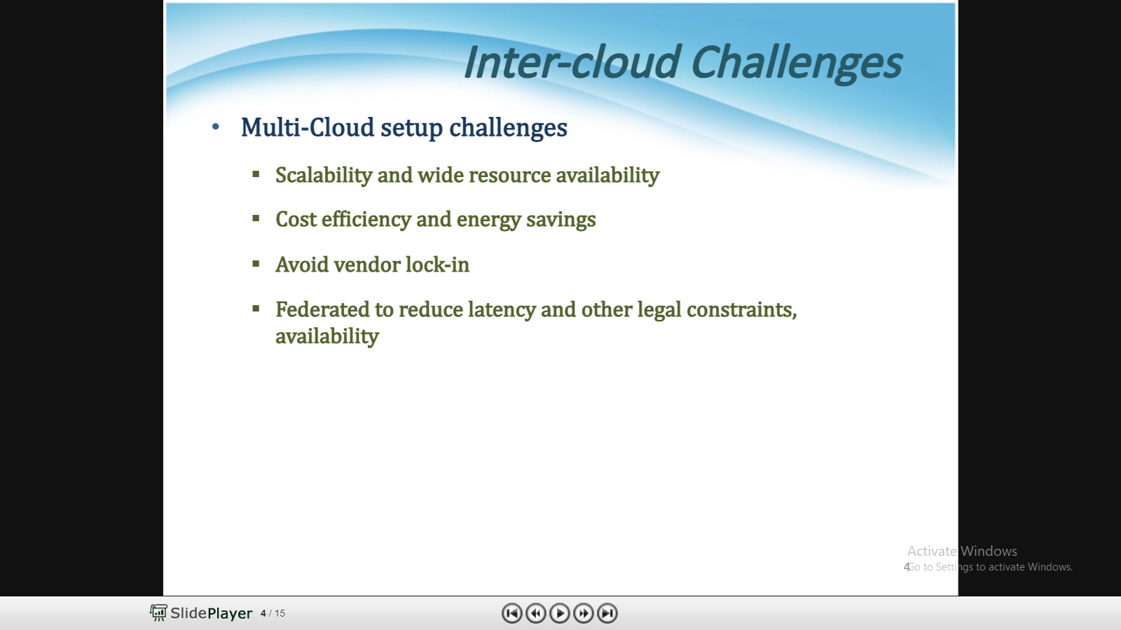

Slide 22
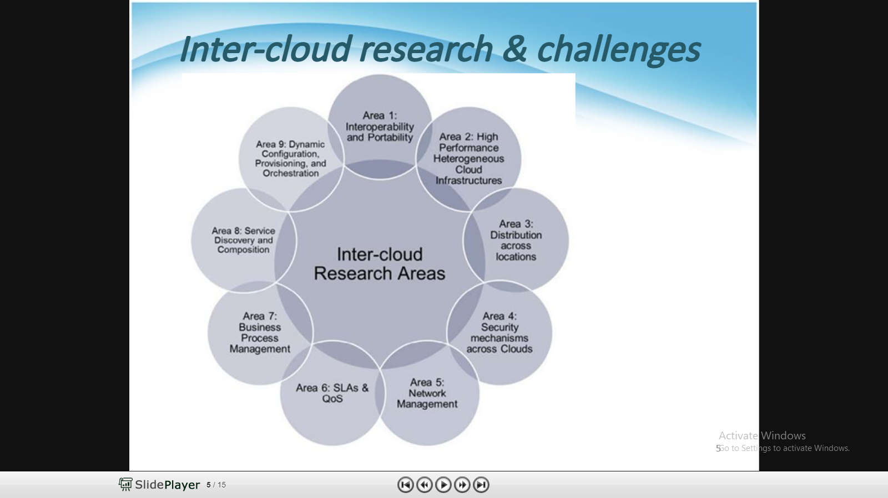

Slide 23
QoS Issues in Cloud
QoS provides guarantee of availability and performance and provide a level of assurance that the resource requirements of an application are strictly supported
QoS is the ability to provide different priority to different applications, users, or dataflow, or to guarantee a certain level of performance .
QoS ability to satisfy stated and implied needs of the user of the service (service quality assurance).
QoS is determined by the fulfilment of both functional and non-functional requirements.

Slide 24
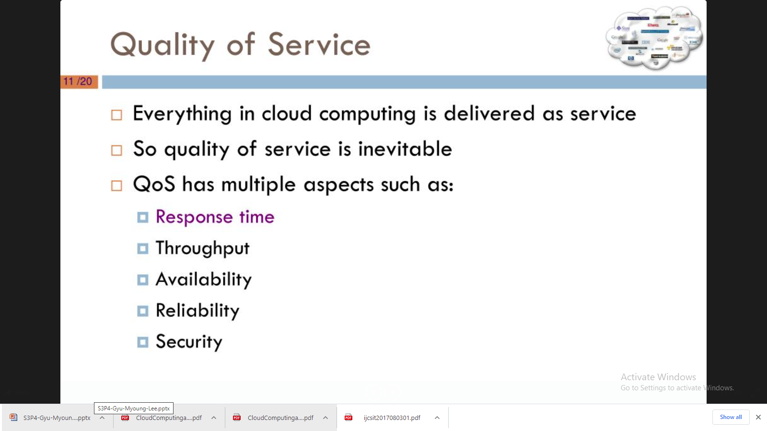

Slide 25
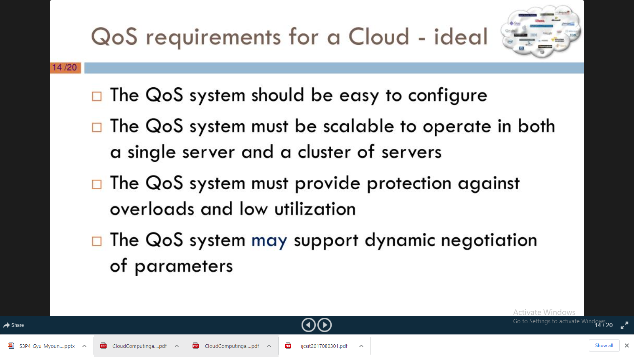

Slide 26
5 issues affecting cloud service quality and performance
1. The demand for cloud services is growing. Cloud computing provides a promising opportunity for enterprises to “address the growing complexity of information technology,” said Barry. “The availability of smartphones and the expectation of immediate and simple access to both private and company-specific information, on a global basis, are driving demand for centralization of IT services, and the related competence required to support these effectively.”
2. Ensuring quality delivery is tricky. One of the fundamental principles of cloud services is the cloud itself, said Barry, which, in most cases, can be read as the Internet. “But how can a cloud service provider assure quality delivery of services across an entity is doesn’t control?” he asked. Service level agreements, or SLAs, can be entered with communication service providers, he said, but how do you ensure the SLAs are being met? “If they’re not being met, how does this affect the services you provide?” he asked. “Can you compensate for this, so the end-user impact can be minimized?”
3. Remote testing could be an answer. Remote testing provides part of the solution, said Barry. According to him, the ability to emulate service experience for potential users, both before service is provided and during service when issues occur, can help with understanding the characteristics of the cloud connecting customers to the cloud service. “Technology already exists that makes remote testing possible,” he added. “Traffic generation technology is available, [which] can be used to stress test networks using typical user traffic.” Traffic can be generated, he said, that will fully load user connections to the cloud service, allowing the individual connection to be tested. And it also allows the cloud service itself to be stress tested, if many of the sessions are established simultaneously.

Slide 27
4. Additional IT helps with precision. “Advanced network adapters now provide synchronized traffic generation features, which can be used by OEM vendors to build traffic generation systems based on standards servers with extreme time precision,” said Barry. Multiple traffic generation systems using these features can be synchronized within a nanosecond.
5. Cloud computing providers can have more control. With this type of technology, Barry continued, cloud computing providers can precisely control when traffic loads or stimulated user sessions are started, and, by using packet-capture technology, analyze and measure the characteristics of the cloud connecting the traffic generators. “This can include latency measurements with extreme accuracy, packet drop analysis, number of TCP resends, total amount of data exchanged, etc.,” he said

Slide 28
QoS monitoring in a Cloud computing environment
Due to the dynamic nature of the cloud, continuous monitoring of the QoS attributes is also necessary to enforce SLA
System of Systems (SoS) approach to provide a clear and concise view of QoS events within cloud computing environment that proactively informs the enterprise operators of the state of the enterprise and enable timely operators response to QoS problems is required
The QoS metrics such as response time, delay and throughput are monitored in the administrative domain in order to improve QoS in the cloud environment.
As cloud provider platforms have diverse characteristics requiring extensive monitoring benchmarking mechanisms to ensure run-time Quality of Service (QoS).
A Current challenge in Cloud environments is to detect any possible SLA violation and to timely react upon it to avoid paying penalties as well as managing resources more efficiently.

Slide 29
Cloud monitoring phase structure is depicted below :
From cloud providers point of view it is very necessary to fulfill SLA to return their customers.
Therefore it is on high priority to monitor QoS parameters so that there is no violation of SLA.
If cloud provider provides sufficient resources, QoS assured automatically. Resources should be provided in balanced way as neither over provisioned nor under provisioned.

Slide 30
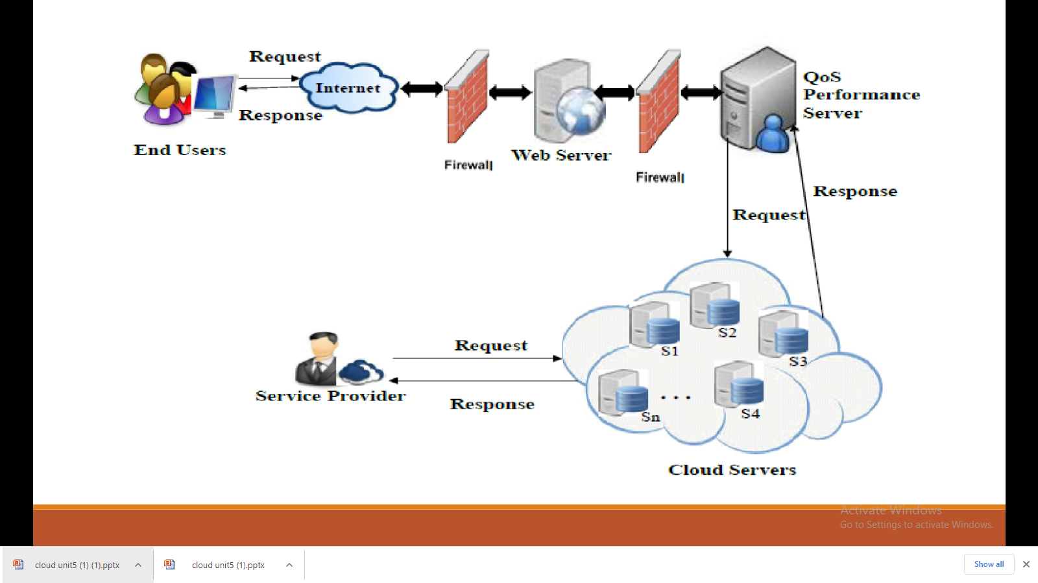

Slide 31
Cloud Middleware
Simply put, middleware is a software platform that sits between an application/device and another application/device. It makes the connection between any two clients, servers, databases or even applications possible; it is not used directly by end users.
Cloud middleware, however, is always accessible to the user in the form of remote software platform for communication or management of data.
cloud middleware provides a number of functionalities to the user.
It helps in the creation of business applications;
facilitates concurrency, transactions, threading and messaging;
provides a service component architecture framework for creating service-oriented architecture (SOA) applications.
Web servers, application servers and databases are examples of cloud middleware.

Slide 32
Mobile Cloud Computing
Mobile Cloud Computing (MCC) is the combination of cloud computing and mobile computing to bring rich computational resources to mobile users, network operators, as well as cloud computing providers.
The ultimate goal of MCC is to enable execution of rich mobile applications on mobile devices, with a rich user experience.
Benefits of Mobile Cloud Computing
Mobile Cloud Computing saves Business money.
Because of the portability which makes their work easy and efficient.
Cloud consumers explore more features on their mobile phones.
Developers reach greater markets through mobile cloud web services.
More network providers can join up in this field.

Slide 34
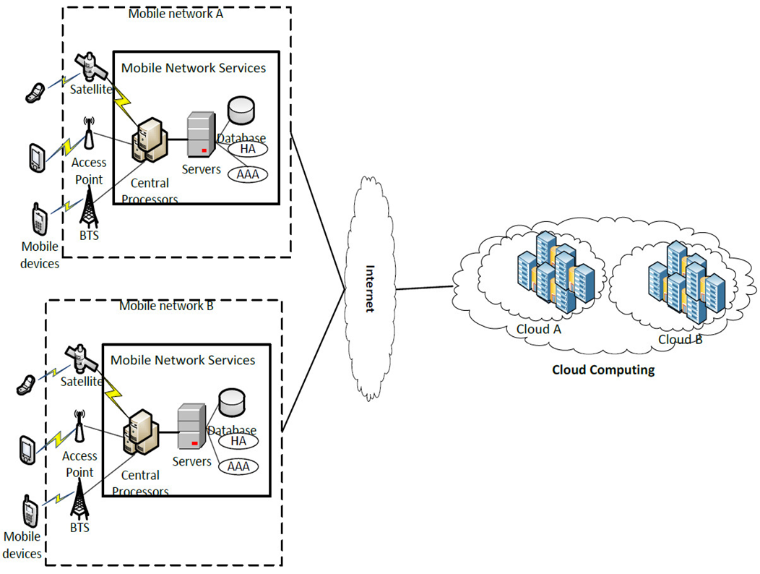
Mobile cloud computing architecture

Slide 35
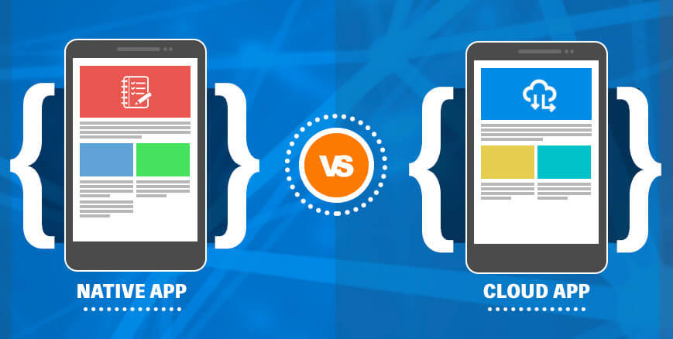
Difference between Mobile Cloud App and Native Mobile App
A native mobile app is installed directly on a mobile device and a separate version may be created for each of the mobile device where the app would be used. It may either be pre-installed on the mobile device or be downloaded from an app store to be installed on the device.
Mobile cloud apps are quite similar to Web-based applications and the main similarity between the two is that they both run on external servers and need the use of browser on the mobile device to display before giving way to the app User Interface.
A mobile cloud app does not need to be downloaded and installed on the device as the app UI can be viewed by the user by way of a browser window on the remote device. These apps need an internet connection to function.

Slide 36





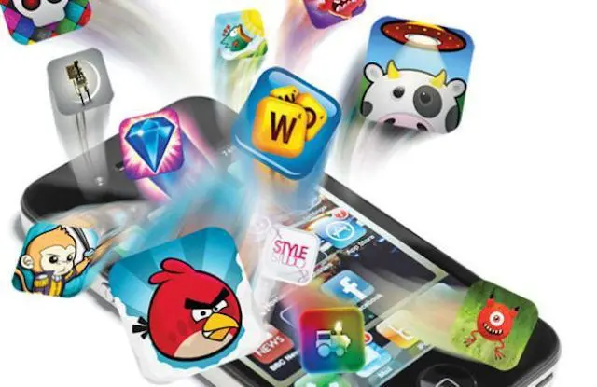
Mobile Cloud Computing Applications
Mobile Email
Mobile Learning
Multimedia Sharing
Mobile Commerce
Mobile Social Networking
Mobile Gaming

Slide 37
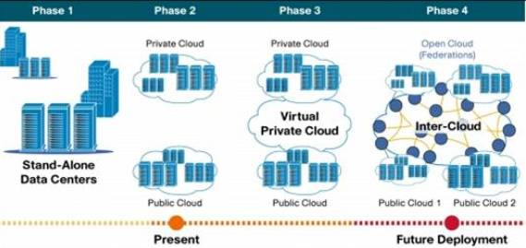
Inter Cloud
The idea behind an intercloud or ‘cloud of clouds’ is that a single common functionality would combine many different individual clouds into one seamless mass in terms of on-demand operations.
The limitations of cloud are that they have limited physical resources. If a cloud has exhausted all the computational and storage resources, it cannot provide service to the clients. The Inter-Cloud addresses such situations where each cloud would use the computational, storage, or any kind of resource of the infrastructures of other clouds
the intercloud would simply make sure that a cloud could use resources beyond its reach by taking advantage of pre-existing contracts with other cloud providers.
INTERCLOUD ARCHITECTURE
Intercloud Architecture (ICA) should address problems with multi-domain heterogeneous cloud based applications integration and interoperability, including integration and interoperability with legacy infrastructure services, and to facilitate interoperable and measurable intra-provider infrastructures and clouds federation.
Researchers at IBM have developed a “drag-and-drop” toolkit that allows users to move file storage across almost any cloud platform.

Slide 38
Types of Inter-Cloud:
Federation Clouds:
A Federation cloud is an Inter-Cloud where a set of cloud providers willingly interconnect their cloud infrastructures in order to share resources among each other.
The cloud providers in the federation voluntarily collaborate to exchange resources. This type of Inter-Cloud is suitable for collaboration of governmental clouds (Clouds owned and utilized by nonprofit institution or government) or private cloud portfolios (Cloud is a part of a portfolio of clouds where the clouds belong to the same organization). Types of federation clouds are Peer to Peer and Centralized clouds.
Multi-Cloud:
In a Multi-Cloud, a client or service uses multiple independent clouds. A multi-cloud environment has no volunteer interconnection and sharing of the cloud service providers’ infrastructures.
Managing resource provisioning and scheduling is the responsibility of client or their representatives. This approach is used to utilize resources from both governmental clouds and private cloud portfolios. Types of Multi-cloud are Services and Libraries.

Slide 39
Inter Cloud issues
The requirements of cloud users often require different resources and the requirements are flexible and unpredictable most of the times.
Application Service Behavior Prediction: It is important that the system should be able to foresee the demands and the behavior of the services. Only when it can predict, it can take decisions intelligently to dynamically scale up and down. Prediction and forecasting models must be built. The challenge is to build such models that accurately learn and fit statistical functions suitable to different behaviors. It is more challenging to correlate between different behaviors of a service.
Flexible Mapping of Services to Resources: It is important to maximize the efficiency, cost-effectiveness and utilization because of high operating costs and energy requirements. The system has to compute the best software and hardware configurations which result in a complex process of mapping services to cloud resources. Mapping of services must guarantee that QoS targets are satisfied along with maximum system efficiency and utilization.

Slide 40
Inter Cloud issues
Economic Models Driven Optimization Techniques: Combinatorial optimization problem is a market driven decision making strategy which searches the optimal combinations of services and deployment plans. Optimization models must be developed which optimize both resource-centric and user-centric QoS targets.
Integration and Interoperability: SMEs have a large amount of IT assets like business applications in their premises and may not be migrated to the cloud. Sensitive data in an enterprise also may not be migrated to the cloud for security reasons and privacy. A need related to integration and interoperability arises between assets on premises and the cloud services. Issues related to identity management, data management, and business process orchestration need to be resolved.
Scalable Monitoring of System Components: The components in a federated system are distributed but the techniques employed for system monitoring and management use centralized approaches. Due to concerns of scalability, performance and reliability arising from the management of multiple service queues and large volume of service requests, centralized approaches are not suitable and architectures using service monitoring and management services based on decentralized messaging and indexing models are needed.

